Slide 1

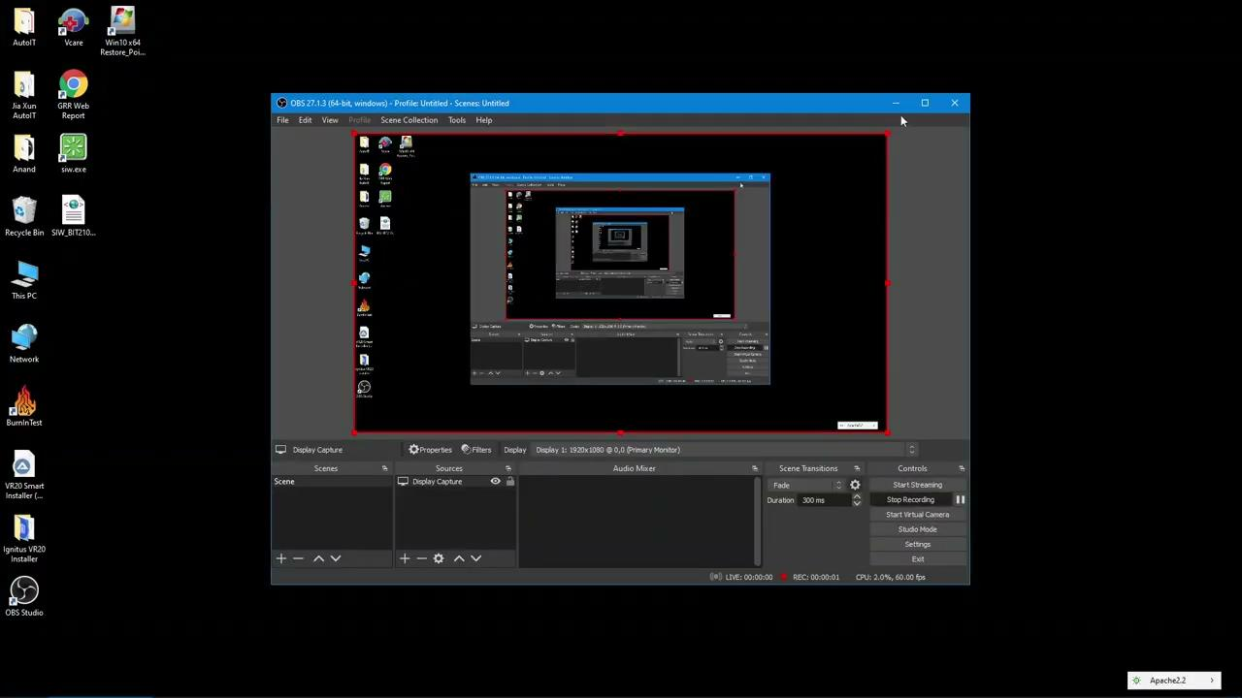
AutoIT task automation
uses a combination of simulated keystrokes, mouse movement and window/control manipulation in order to automate tasks
AutoIT is a great solution for:
Automating repetitive and standardized tasks
Creating GUI for easy access to common files, applications or settings

Slide 2
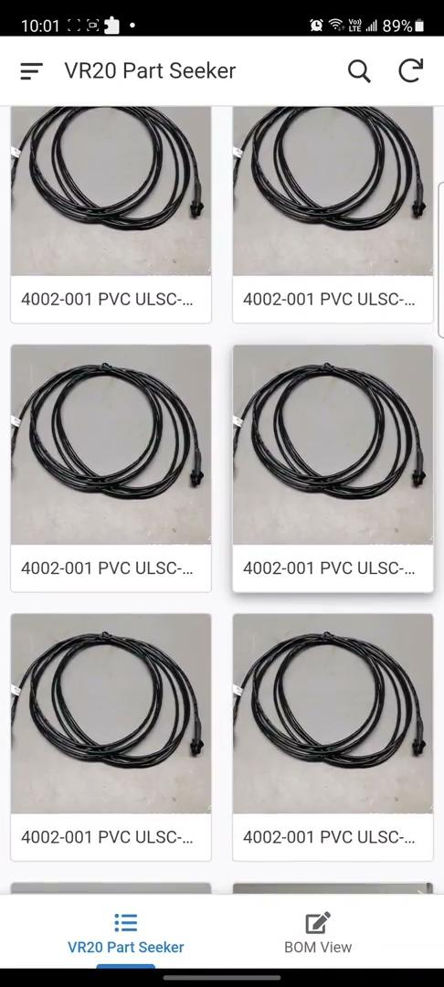
VR20 Part Seeker
An AppSheet app that:
Syncs with Google Sheet data
Works on mobile and browser
Allows users to search parts based on Part ID, Part Description, BOM and MPN
Shows user the part details (Picture, ID, Description, BOM and MPN)
QR scanning enables quick scan to find part

